Slide 1
Hydrostatic Lubrication
Presented by
Kannan MV, SR No:08948,
IISc, Bangalore

Slide 2
Hydrostatic Lubrication
Lubrication :-
Lubrication is the process employed to reduce wear of one or both surfaces in close proximity, and moving relative to each other, by interposing a substance called lubricant between the surfaces.
The interposed lubricant film can be a solid, (e.g. graphite, MoS₂),a solid/liquid dispersion, a liquid, a liquid-liquid dispersion (a grease) or a gas.
Lubrication reduces or minimizes friction and wear;
It helps to cool the surfaces and carries away heat from the moving parts,
It minimizes oxidation of metals (rust) and to clean the surfaces of the metal by carrying away very small solid deposits.

Slide 3
Lubrication Regimes
The thickness of the fluid film determines the lubrication regime, or the type of lubrication. The basic regimes of fluid film lubrication are:
Fluid film lubrication – is the lubrication regime in which the load is fully supported by the viscous forces of lubricant and solid–solid contact is avoided
Elastohydrodynamic lubrication –Here the two surfaces are separated by a very thin fluid film.
Also there is an elastic deformation on the contacting surface enlarging the load-bearing area whereby the viscous resistance of the lubricant becomes capable of supporting the load.
Hydrostatic lubrication is when an external pressure is applied to the lubricant in the bearing, to maintain the fluid lubricant film where it would otherwise be squeezed out.
Hydrodynamic lubrication is where the motion of the contacting surfaces, and the exact design of the bearing is used to pump lubricant around the bearing to maintain the lubricating film

Slide 4
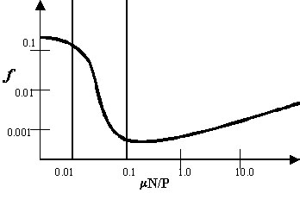
Lubrication Regimes(Cont.)
Mixed lubrication – This regime is the transition between the Hydrodynamic and Boundary lubrication. Two surfaces are partly separated, partly in contact.
Boundary lubrication – Two surfaces mostly are in contact with each other even though a fluid is present. The bodies come into closer contact at their asperities; the heat developed by the local pressures causes a condition which is called stick-slip and some asperities break off
Stribeck Curve showing different lubrication regimes

Slide 5
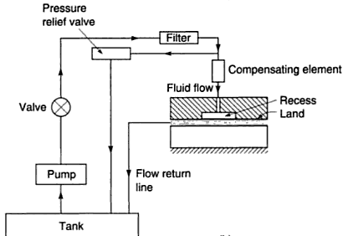
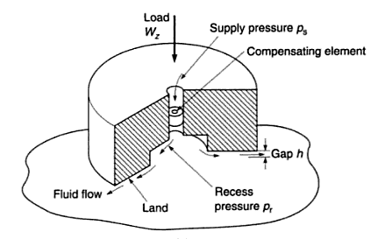
Hydrostatic Lubrication
Hydrostatic lubrication is characterized by the complete separation of the conjugated surfaces of a kinematic pair, by means of a film of fluid, which is pressurized by an external equipment like a pump.
Its distinguishing features are lack of wear, low friction, high load capacity, a high degree of stiffness and the ability to damp vibrations.
It differs from hydrodynamic lubrication in that the contact pressure is generated by an external pump instead of by viscous drag.
Hydro static thrust bearing with circular step pad
Fluid supply system

Slide 6
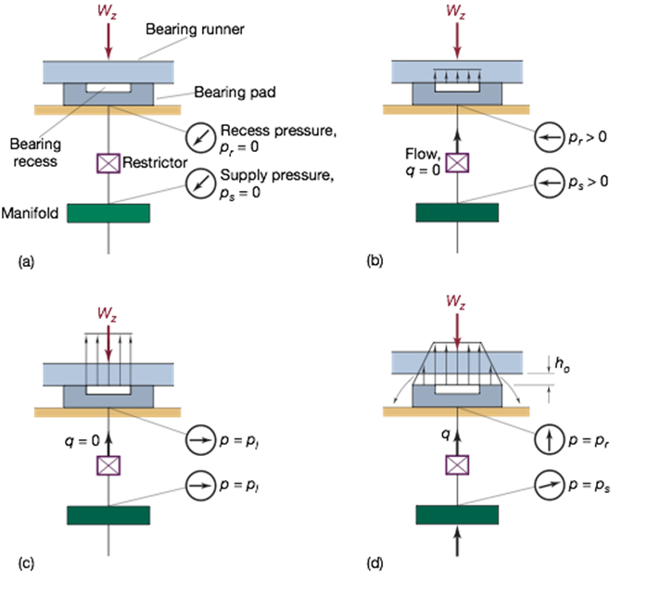
Formation of fluid film in hydrostatic bearing system.
Pump off
Pressure build up
Pressure times recess area equals normal applied load
Bearing operating
[From Rippel (1963)]

Slide 7
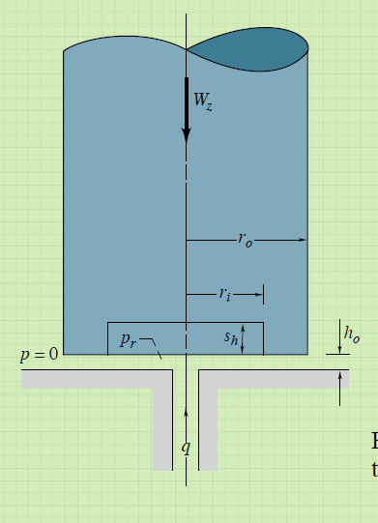
Hydrostatic thrust bearing system.
Flat hydrostatic thrust bearing
with circular step pad.
Conical thrust bearing
.

Slide 8
General Characteristics of hydrostatic bearings
A complete lubricant film can be present at even zero sliding speed due to the external pressurization.
Hydrostatic films usually have thickness upto 100 microns.
Large starting friction problems are totally eliminated in hydrostatic lubrication.
Hydrostatic bearings possess zero static friction and high load capacity and stiffness
The highest axial bearing stiffness, self-aligning capability and the minimal flow is obtained with the smallest film thickness.
Hydrodynamic bearings assisted by an externally pressurized lubricant supply are known as hybrid bearings

Slide 9
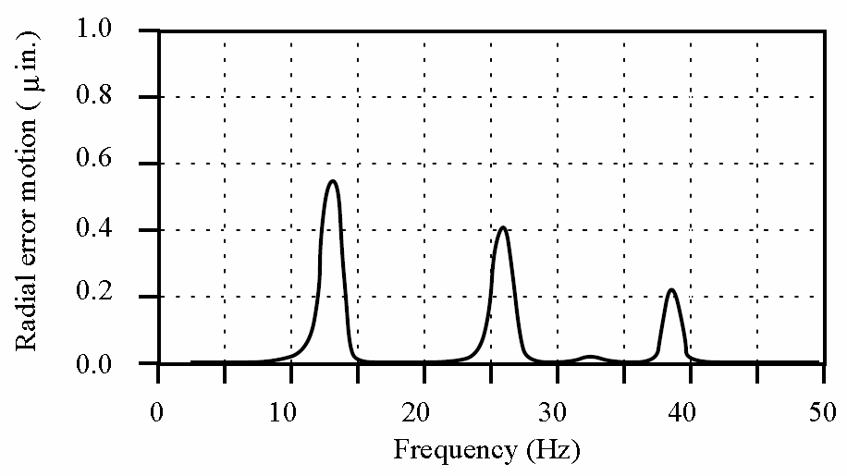
General Characteristics of hydrostatic bearings
Lack of mechanical contact between elements causes error motions to be small and harmonics quickly die out.

Slide 10
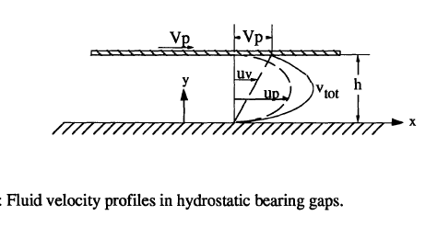
Hydrostatic bearing analysis
Pressure distribution for a circular
step hydrostatic thrust bearing
Fluid velocity profile in bearing gap
Pressure distribution
µ-coeff. of dynamic viscosity,Q- Total discharge,h- fluid film thickness, R-Radius of bearing.
Total normal load carried by the bearing

Slide 11
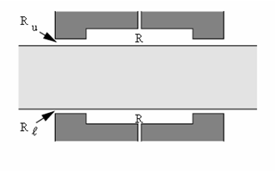
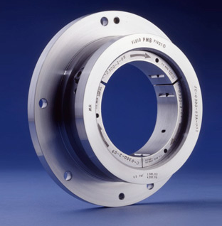
Types of Compensation
Compensation is the process by which the inlet flow is restricted in order to support varying loads.
Hydrostatic bearings need a flow restrictor in order to support varying loads.
There are different types of bearings distinguished by the kind of flow restrictors that regulates the inlet flow into the bearing pocket.
The design of flow restrictors is crucial as it determines the overall performance of bearing and cost to some extent.
Constant supply pressure restrictors (Fixed Compensation)
Constant supply pressure restrictors are generally used for compensation. Most commonly used restrictors are capillary and orifice
Recess pressure is kept lower than supply pressure
Drop in pressure, from supply pressure to recess pressure is controlled by the fixed restrictor placed between supply manifold and the bearing.
Increase in load, reduces the flow by decreasing film thickness, recess pressure increases and equilibrium is restored.

Slide 12
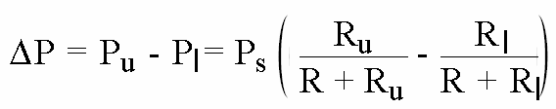
Principle of fixed compensation.

Slide 13
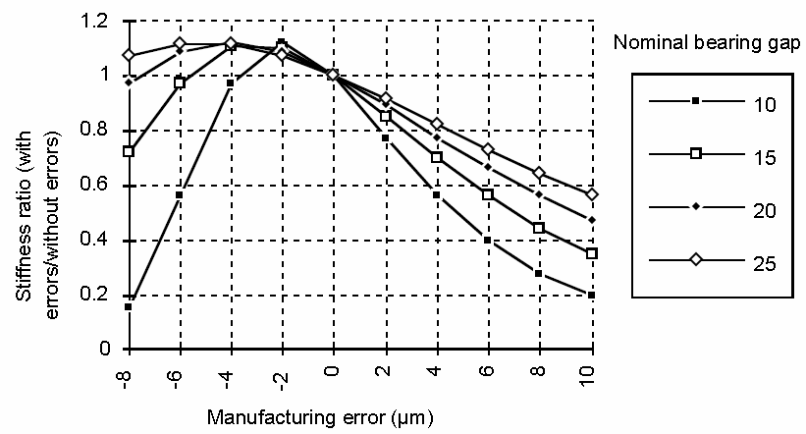
Effect of mfg. errors on capillary compensated bearing:

Slide 14
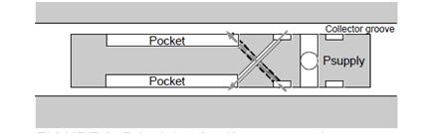
Principle of Self Compensation(Active Compensation)
Self compensation provides greater stiffness and load capacity.
It makes the system insensitive to manufacturing tolerances:
The bearings are self-tuning:
The stiffness automatically optimizes itself for the bearing as soon as it is turned on.
No manual tuning of capillary or orifice size is required.

Slide 15
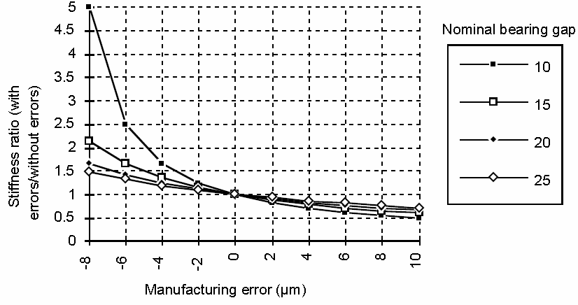
Effect of mfg. errors on self compensated bearing

Slide 16
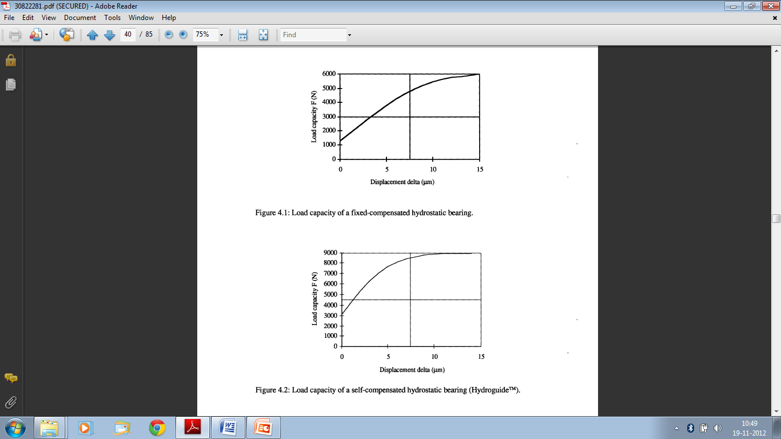
Comparison between fixed & self compensated hydrostatic bearing

Slide 17
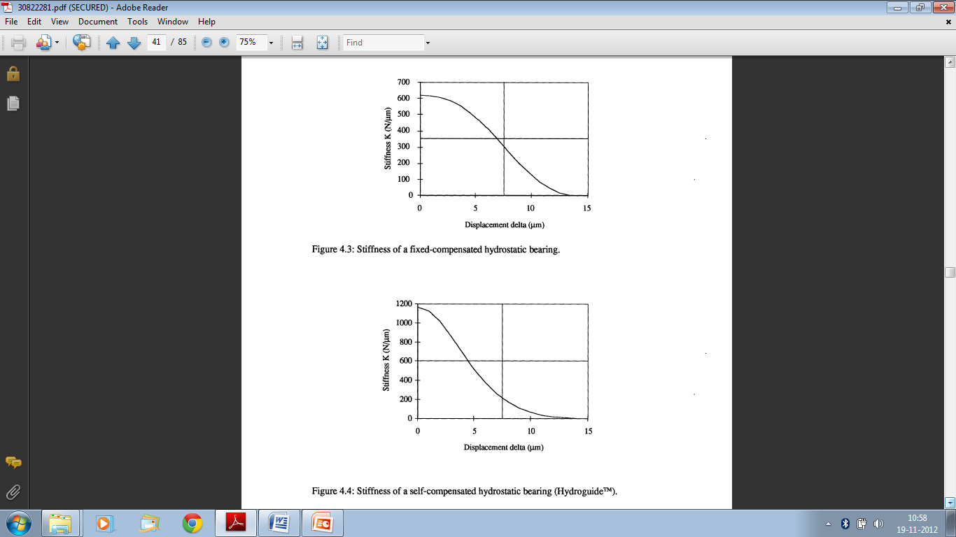
Comparison between fixed & self compensated hydrostatic bearing

Slide 18
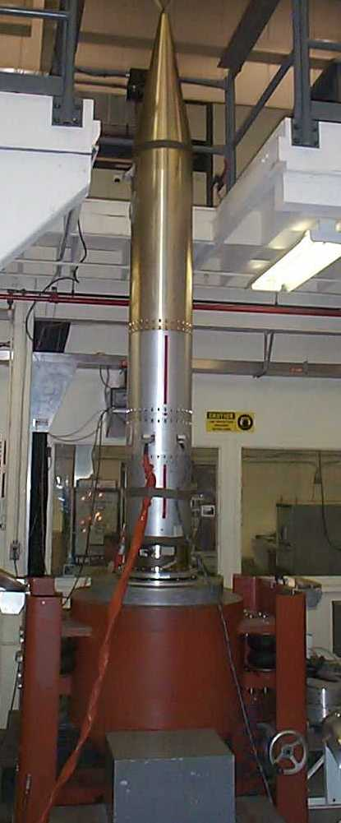
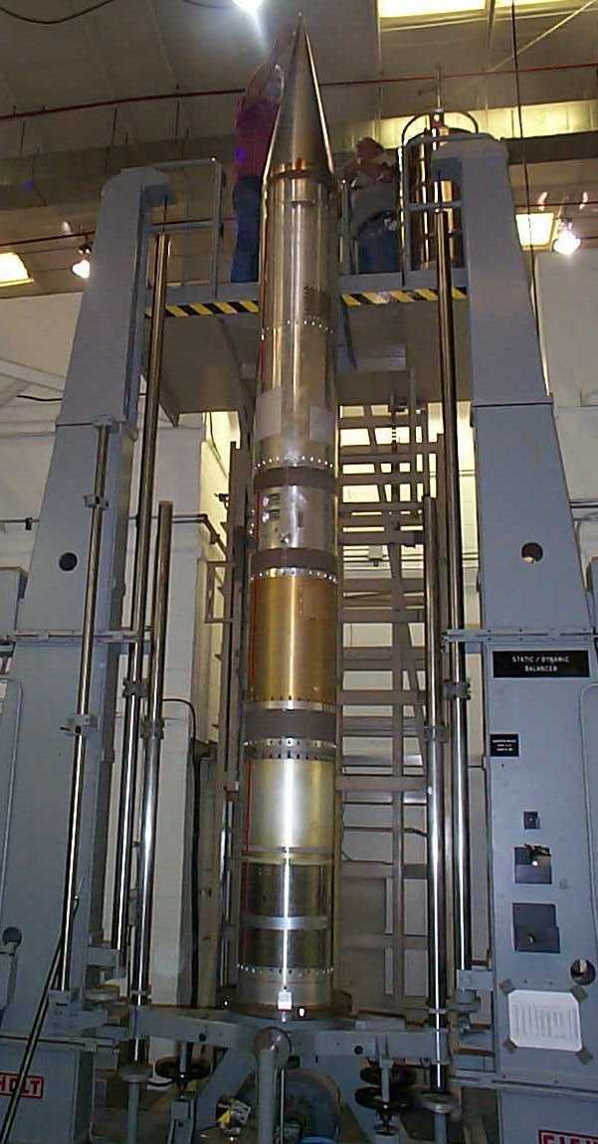
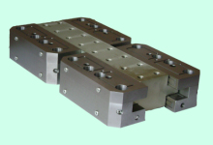
Dynamic balancing of rocket payload
Applications of Hydrostatic lubrication
Horizontal slip table guided by hydrostatic bearing.
Thrust axis vibration of Rocket Payload

Slide 19
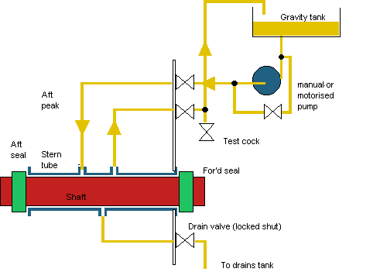
Applications of Hydrostatic Lubrication(cont.)

Slide 20
References
WATER HYDROSTATIC BEARINGS FOR PRECISION MACHINE TOOLS AND INDUSTRIAL MACHINERY ( Alexander H. Slocum, Dept of ME,MIT )
INTRODUCTION TO TRIBOLOGY (Bharat Bhushan)
ENGINEEERING TRIBOLOGY (Gwidon W Stachowiak & Andrew W Batchelor)

Slide 21
THANK YOU

Slide 22
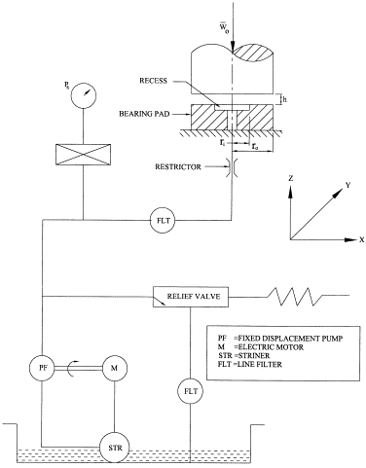

Slide 23
Oil is typically used for ease of pumping and its inherent lubricity in case of pressure loss. In many applications, such as grinding of ceramics, high speed spindles, and industrial applications, such as paper machinery, water would be the preferred working fluid.
A great challenge is
flora and fauna readily grow in water, and can
cause inlet flow restrictors to clog which results
in bearing failure.
The larger the size of the pocket, the larger the load capacity and self-aligning capability of the bearing.
A small diameter of the inlet hole is favorable with respect to the self-aligning capability of the bearing but may cause the pressure to drop locally by inertia forces.
The highest load capacity is obtained with small h0/h2 ratio which means a relative large pocket depth h2. A shallow pocket however is needed to obtain axial bearing stiffness and self aligning capability.

Slide 24
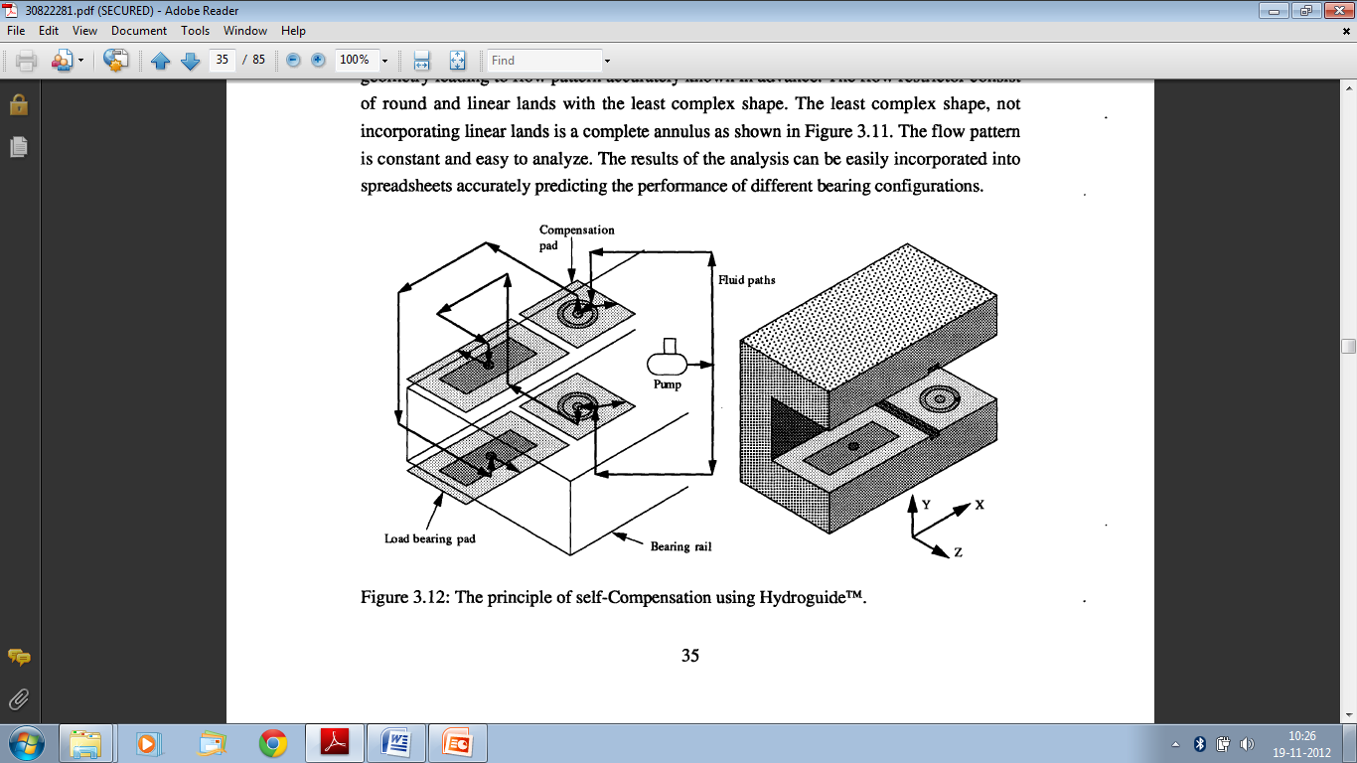
Self compensation

